Slide 1
Deep Learning Lecture – 1 (CNN)
Sukho Lee(이석호)
Dongseo Univ.
@울산대학교 2018.1.15~16

Slide 2
Very simple 2x2 image recognition
0
2
2
0
2
0
0
2
Human image
Dog image

Slide 3
Very simple 2x2 image recognition
0
2
1
1
-1
1
-
=
2
0
1
1
1
-1
Human image
Mean
Normalized
Human image
2
0
-
1
1
-1
1
=
0
2
1
1
1
-1
Dog image
Mean
Normalized
Dog image

Slide 4
-1
-1
1
1
A
1
-1
Human
B
1
-1
A = -1 + 1 + 1 + -1

Slide 5
-1
-1
1
1
-1
1
A
Human
B
1
-1
A = -1 + 1 + 1 + -1
Problem : If can have only a value of -1 or 1,
What are the weights that make A largest?

Slide 6
-1
-1
1
1
-1
1
A
human
B
1
These weights activate the human
node the most
-1
A = -1 + 1 + 1 + -1
Problem : If can have only a value of -1 or 1,
What are the weights that make A largest?

Slide 7
1
-1
-1
1
A
dog
B

Slide 8
1
1
-1
-1
-1
1
A
-1
B
1
B = 1 + -1 + -1 + 1
Problem : If can have only a value of -1 or 1,
What are the weights that make A largest?

Slide 9
These parameters are found automatically (by backpropagation)

Slide 10
1
1
-1
-1
-1
1
A
-1
1
-1
B
=
-1
1
1
=
1
-1
-1
1
B = 1 + -1 + -1 + 1

Slide 11
Very simple 3x3 image recognition
Human
dog

Slide 14
9
-1
9 > -1 : Human

Slide 15
-1
9
-1 < 9 : dog

Slide 16
Human without arm
Dog without hind leg

Slide 17
7
-3
7 > -3 Human

Slide 18
1
7
1 < 7 dog

Slide 19
2-D convolution
1
-1
1
1
1
1
1
-1
1
-1
-1
-1
1
-1
-1
-1
-1
1
1
-1
1
-1
1
1
1
-1
1
1
1
1
1
-1
1
1
-1
1
-1
-1
-1
1
-1
1
1
-1
1
1*1 + 1*(-1) + 1*1
+ 1*(-1) + (-1) *(-1) + (-1)*1
+ (-1)*1 + 1*(-1) +1*1 =-1
(-1)*1 + 1*(-1) + (-1)*1
+ 1*(-1) + 1 *(-1) + (-1)*1
+ 1*1 + 1*(-1) +1*1 =1
1*1 + 1*(-1) + 1*1
+ (-1)*(-1) + 1 *(-1) + (-1)*1
+ 1*1 + (-1)*(-1) +1*1 =3
1*1 + (-1)*(-1) + 1*1
+ (-1)*(-1) + (-1) *(-1) + (-1)*1
+ 1*1 + (-1)*(-1) +1*1 =7
(-1)*1 + (-1)*(-1) + (-1)*1
+ 1*(-1) + (-1) *(-1) + 1*1
+ 1*1 + 1*(-1) +1*1 =1
(-1)*1 + 1*(-1) + 1*1
+ (-1)*(-1) + (-1) *(-1) + 1*1
+ (-1)*1 + 1*(-1) +(-1)*1 =-1
7
-1
3
-1
1
1
and so on…

Slide 20
Practice
Compute the convolution between the following image and filter
10
10
12
11
5
4
10
12
13
5
5
4
-1
0
1
11
11
13
4
5
4
-1
0
1
*
10
11
12
4
5
4
-1
0
1
11
12
4
3
4
4
filter
(mask)
11
11
4
4
4
4
image

Slide 21
-1
1
-1
-1

Slide 22
1
1
-1
-1

Slide 23
-1
-1
-1
1

Slide 24
-1
-1
1
1

Slide 25
Suppose the network is
partially connected and that
the nodes in the next
layer share the same weights.
Then the left network
performs the same operation
as the convolution.

Slide 26
The previous network can be represented by the following convolution expression
-1
1
1
=
-1
-1
-1
*
-1
1
1

Slide 27
Assume we have the following weight filter (which maybe
looks like an ear)
-1
1
=
-1
-1
filter
ear
Among the values , is the largest.
Why? is obtained when the filter is overlapped with
this region. This region is the most similar to the filter
-1
1
1
=
-1
-1
-1
*
-1
1
1

Slide 28
-1
1
-1
-1

Slide 29
This node has a large value.
(This node is activated)
This means that something looking
like the ear is in the upper left
region of the image.
-1
1
-1
-1
ear

Slide 30
Assume we have the following weight filter (which maybe
looks like an ear)
-1
-1
=
1
1
filter
eye
Among the values , is the largest.
Why? is obtained when the filter is overlapped with
this region. This region is the most similar to this filter
-1
1
1
=
-1
-1
-1
*
-1
1
1

Slide 31
-1
-1
1
1

Slide 32
Activated (ear)
-1
1
-1
-1
This image has an ear in the upper left region and an eye in the lower right region
-1
-1
1
1
Activated (eye)

Slide 33
1
Ear in the first
region and eye in
the first region
0
1
-1
1
-1
-1
Ear in the first
region, eye in
the second
region
…….
Ear in the second
region, eye in
the first region
-1
-1
…….
1
1
Ear in the last
region, eye in
the last
region

Slide 34
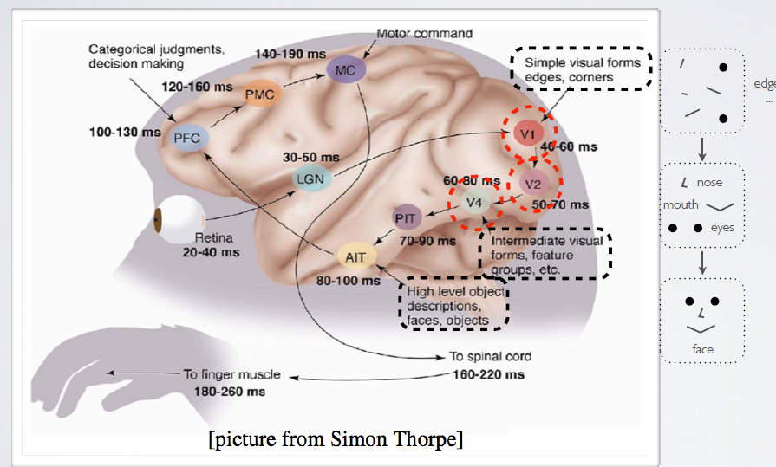

Slide 35
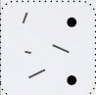
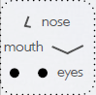
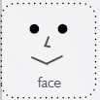
-1
1
-1
-1
face
-1
-1
1
1

Slide 36
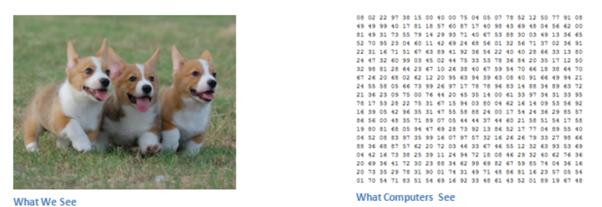
https://adeshpande3.github.io/adeshpande3.github.io/A-Beginner's-Guide-To-Understanding-Convolutional-Neural-Networks/

Slide 37
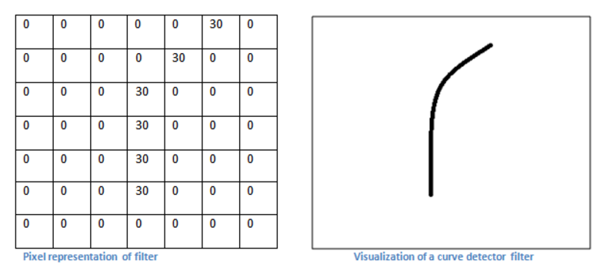
https://adeshpande3.github.io/adeshpande3.github.io/A-Beginner's-Guide-To-Understanding-Convolutional-Neural-Networks/

Slide 38
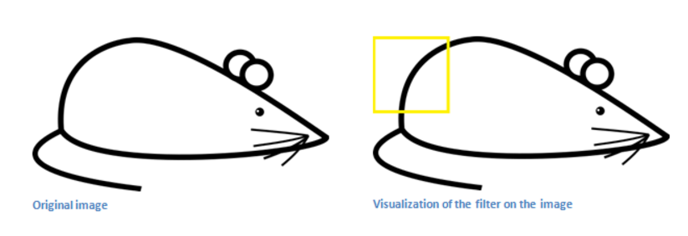

Slide 39
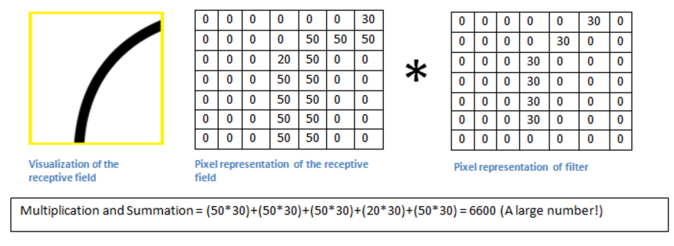

Slide 40
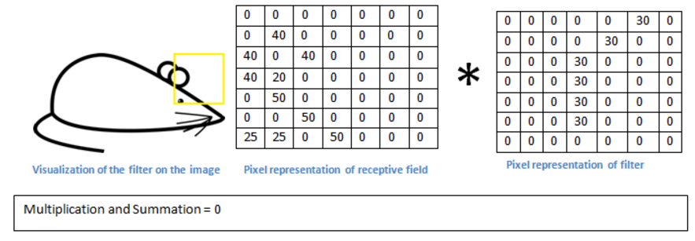

Slide 41
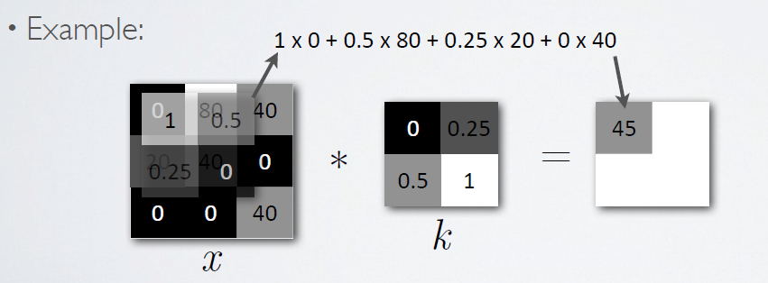
2-D Convolution
image
kernel = window = mask = weight

Slide 42
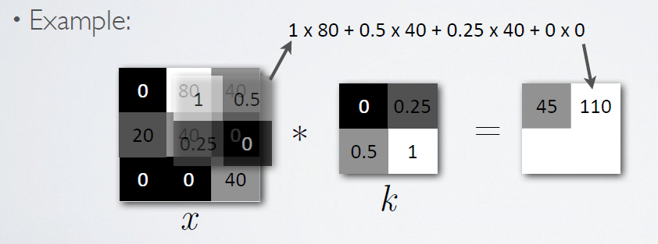
2-D Convolution

Slide 43
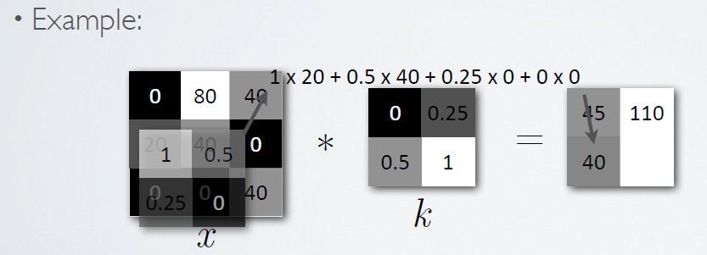
2-D Convolution

Slide 44
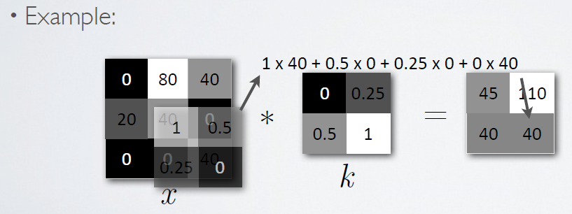
2-D Convolution

Slide 45
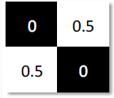
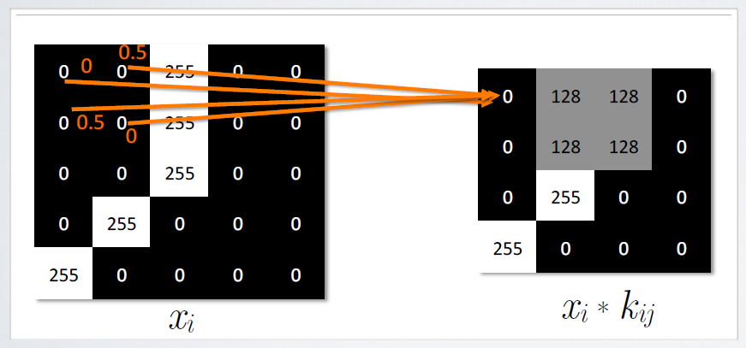
2-D Convolution
kernel

Slide 46
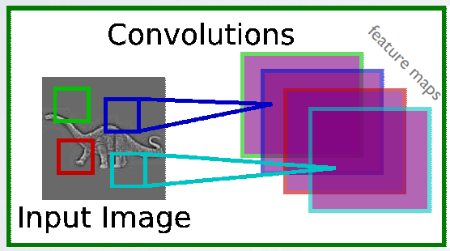
2-D Convolution

Slide 47
Need for Non-linear function
a
1
b
c
0
6
d
0
1
0
1
3
1
0
1
0
0
0
1
0
1
e
1
2
f
0
g
h
Concatenate Matrices can be expressed
By a single matrix
→Same as a neural network
with only one layer
a
b
6
0
c
3
d+a
b
0
c
d
0
2

Slide 48
Need for Non-linear function
a
1
b
c
0
6
d
0
1
0
1
3
1
0
1
0
0
0
1
0
1
e
1
2
f
0
g
h
Non-linear function like Tanh(), Sigmoid, ReLU, Max pooling etc. has to be
Put between the layers.

Slide 49
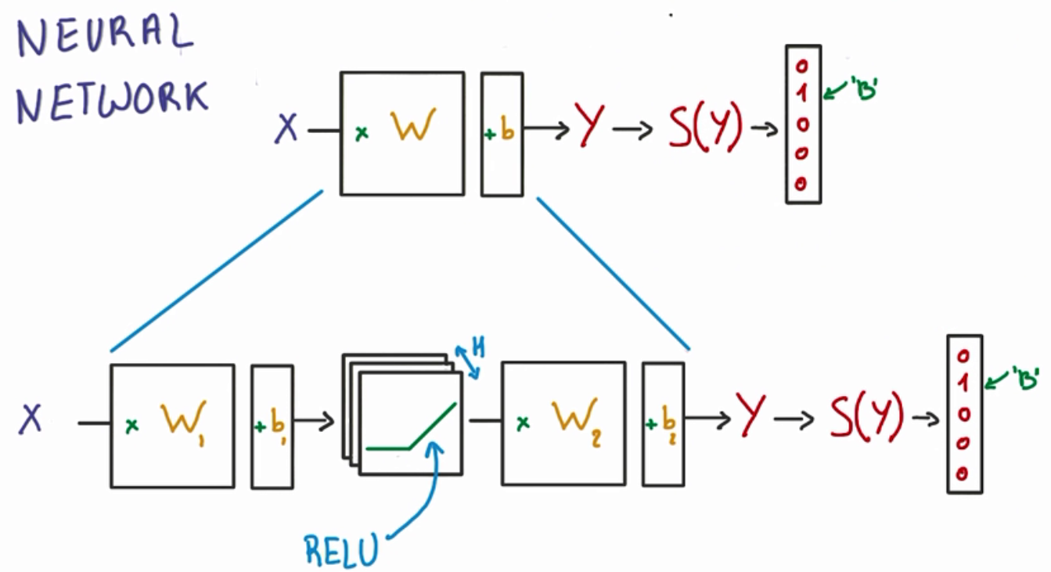
Non-linear function
Putting non-linear functions between networks

Slide 50
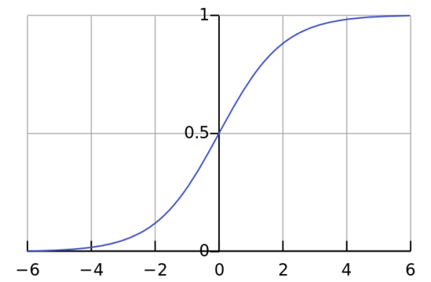
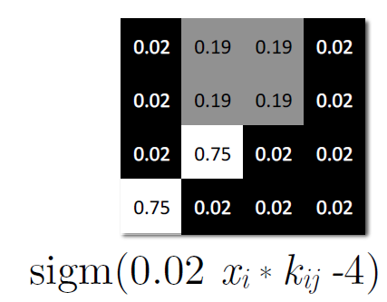
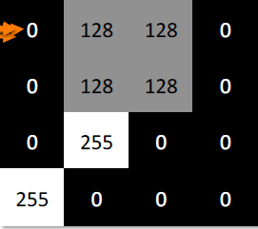
Non-linear function
Sigmoid function

Slide 51
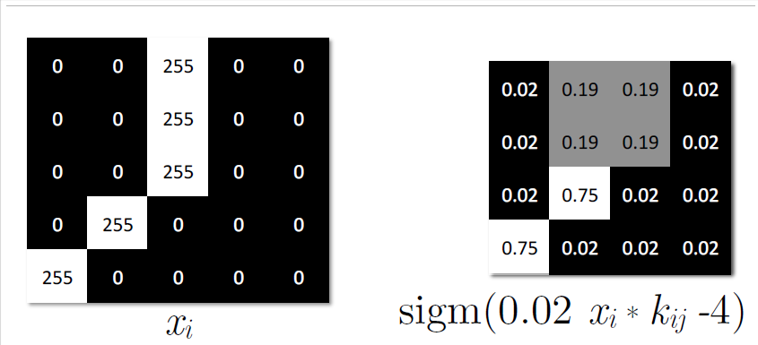
Non-linear function

Slide 52
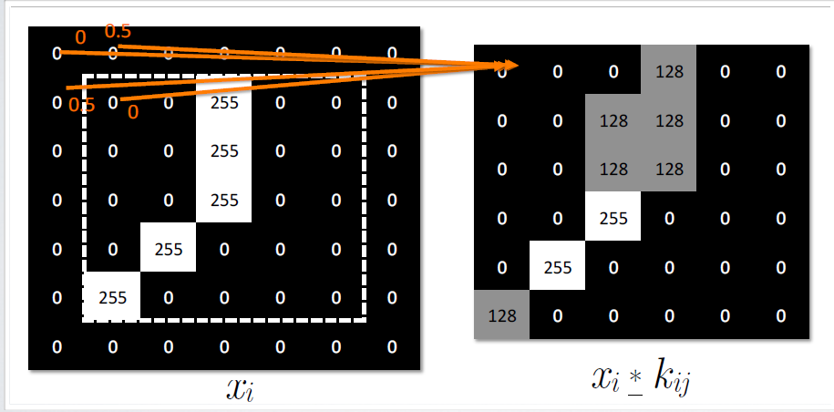
Boundary Processing

Slide 53
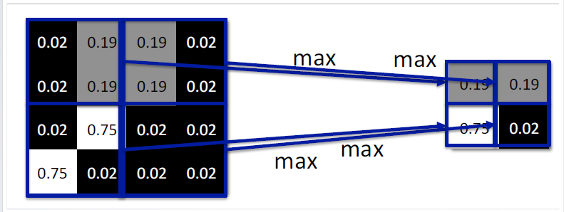
Max Pooling

Slide 54
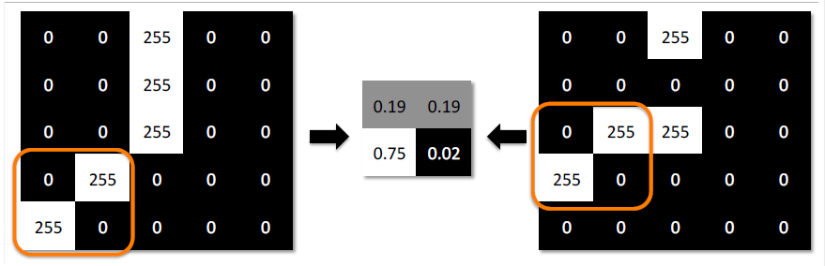
Invariance of small changes

Slide 55
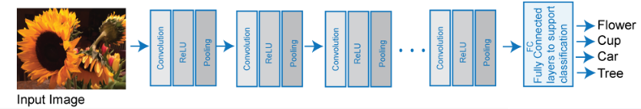
Deep Convolutional Neural Network
Non-linear function

Slide 56
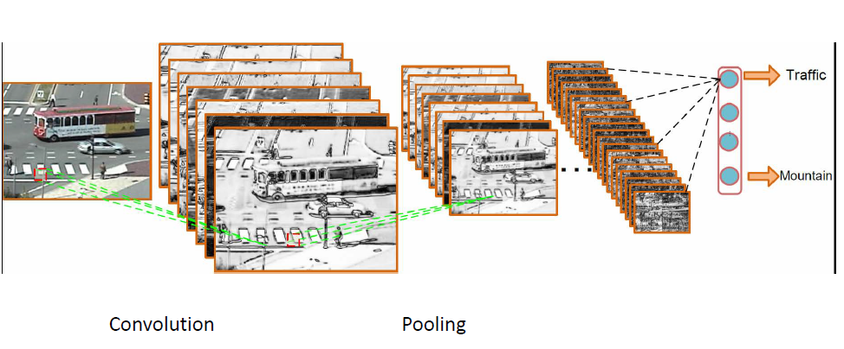
Deep Convolutional Neural Network
depth
Slides by Abin - Roozgard

Slide 57
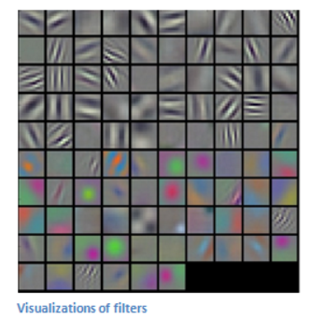
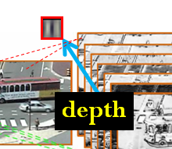
Deep Convolutional Neural Network
Not manually given but found automatically
by backpropagation

Slide 58
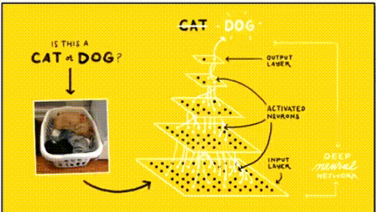
Deep Convolutional Neural Network

Slide 59
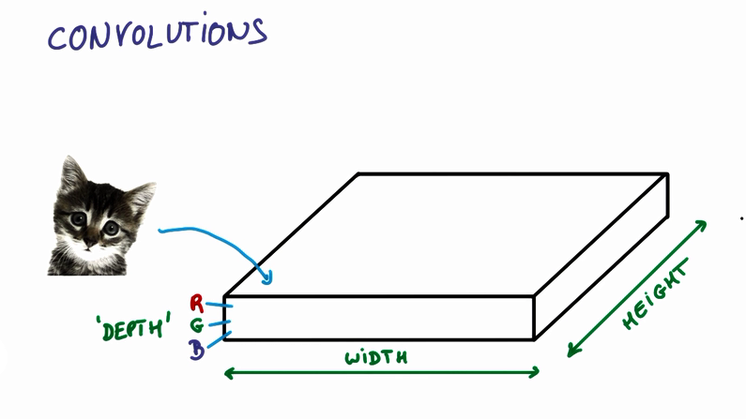
Parameters in Convolution

Slide 60
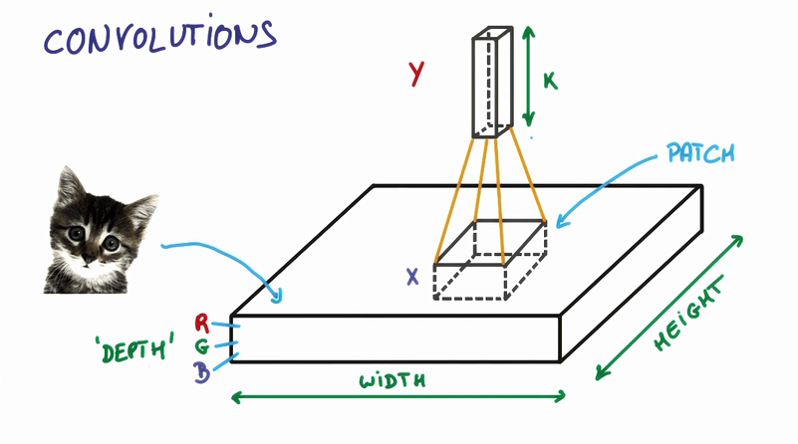
Parameters in Convolution
Input : [batch, in_height, in_width, in_channels]
Number of images in batch

Slide 61
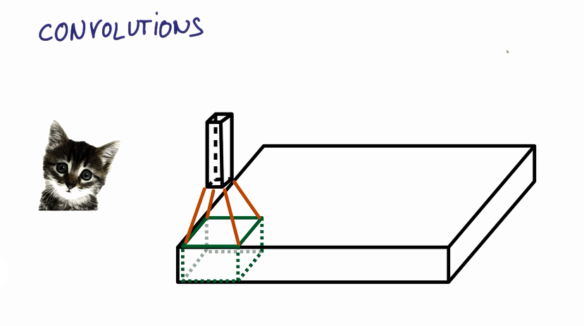
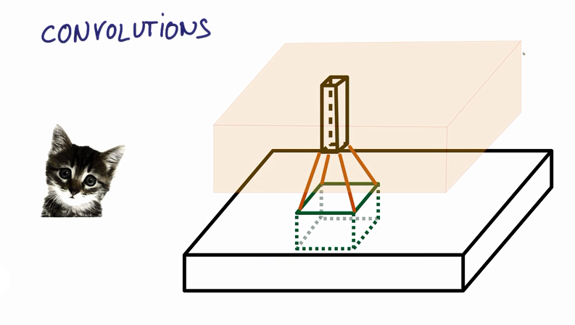
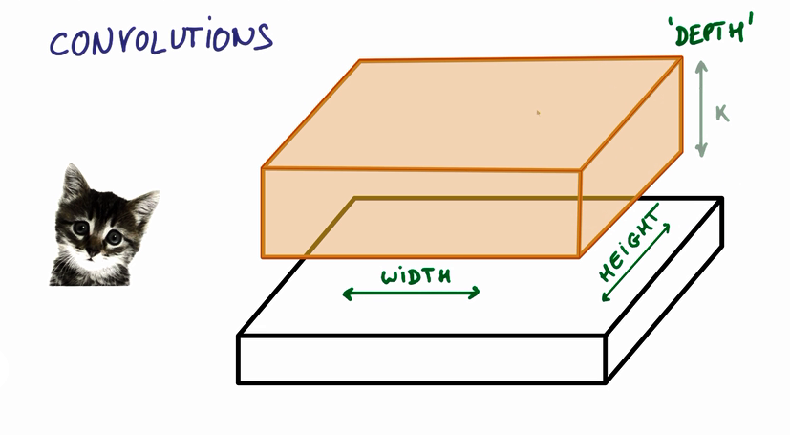
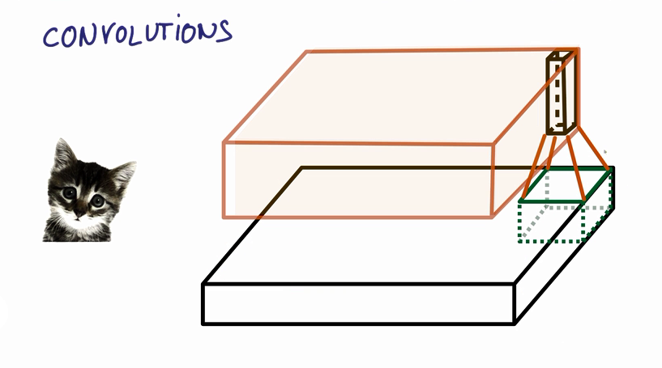

Slide 62
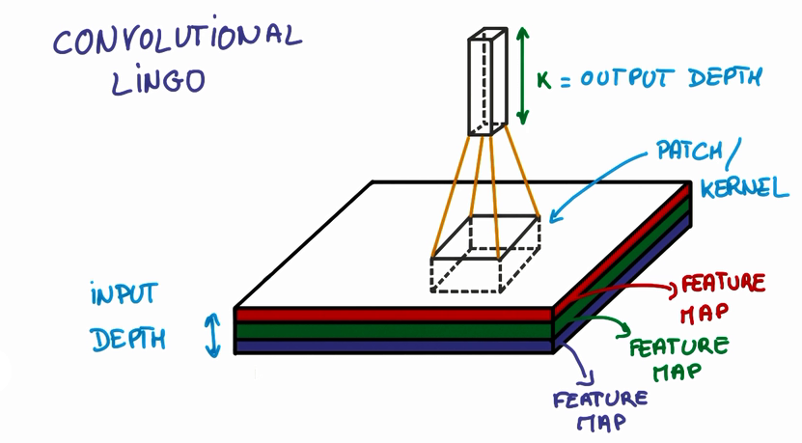
Parameters in Convolution
filter [filter_height, filter_width, in_channels, out_channels]

Slide 63
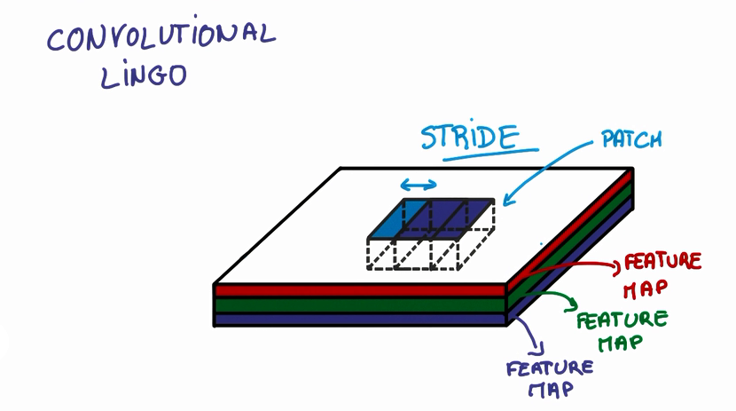
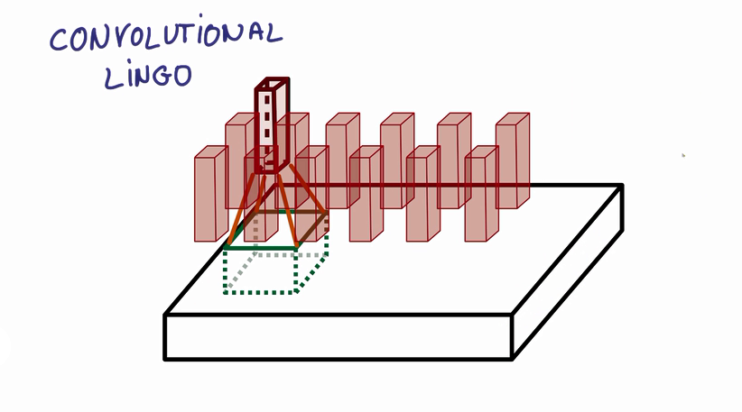
Parameters in Convolution
strides = [1, 2, 2, 1]

Slide 64
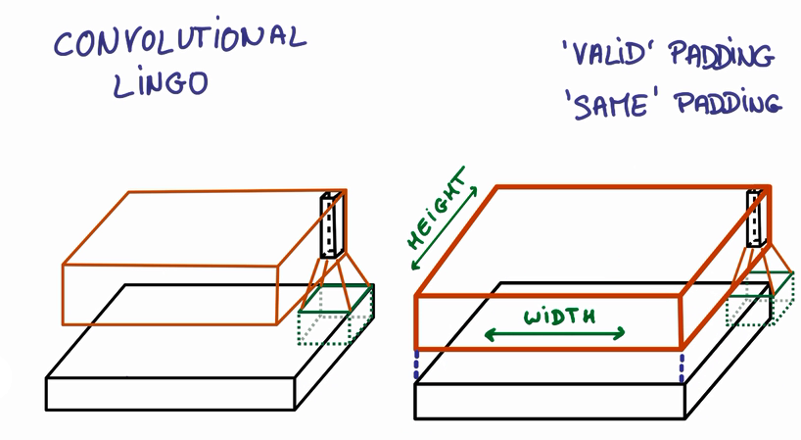
Parameters in Convolution
Padding = ‘valid’
Padding = ‘same’

Slide 65
Tensorflow Practice5 : Convolutional Neural Network

Slide 66
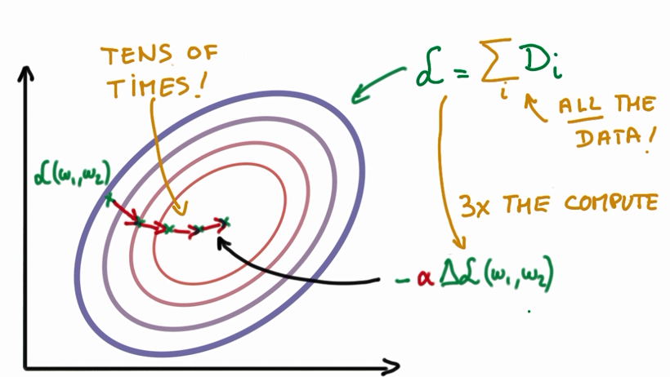
Stochastic Gradient Descent
(figure from udemy site)

Slide 67
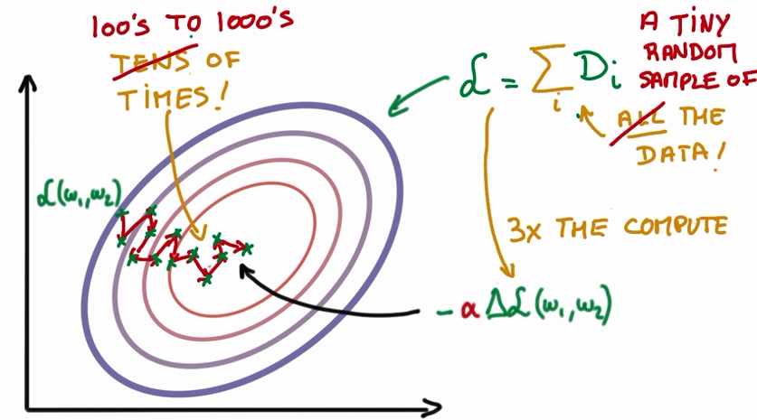
Stochastic Gradient Descent
(figure from udemy site)

Slide 68
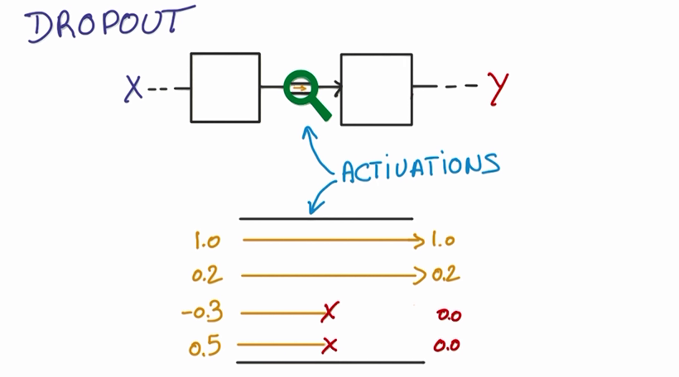
Dropout
(figure from udemy site)

Slide 69
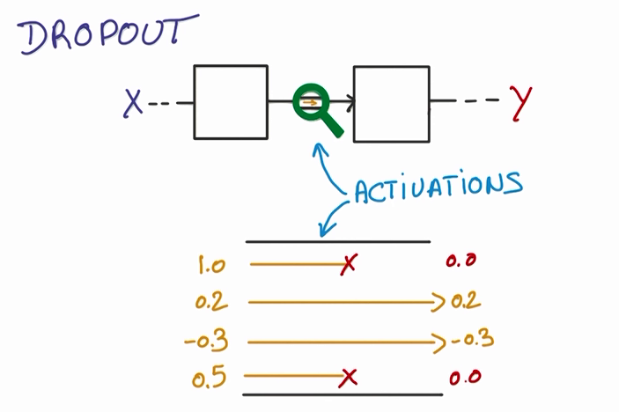
Dropout
(figure from udemy site)

Slide 70
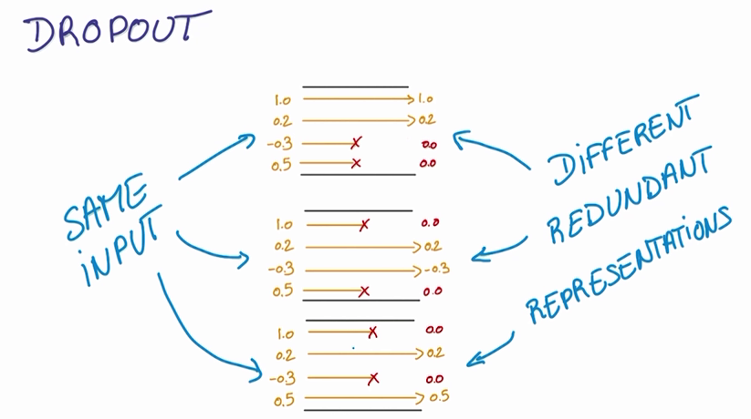
Dropout
(figure from udemy site)

